Slide 1
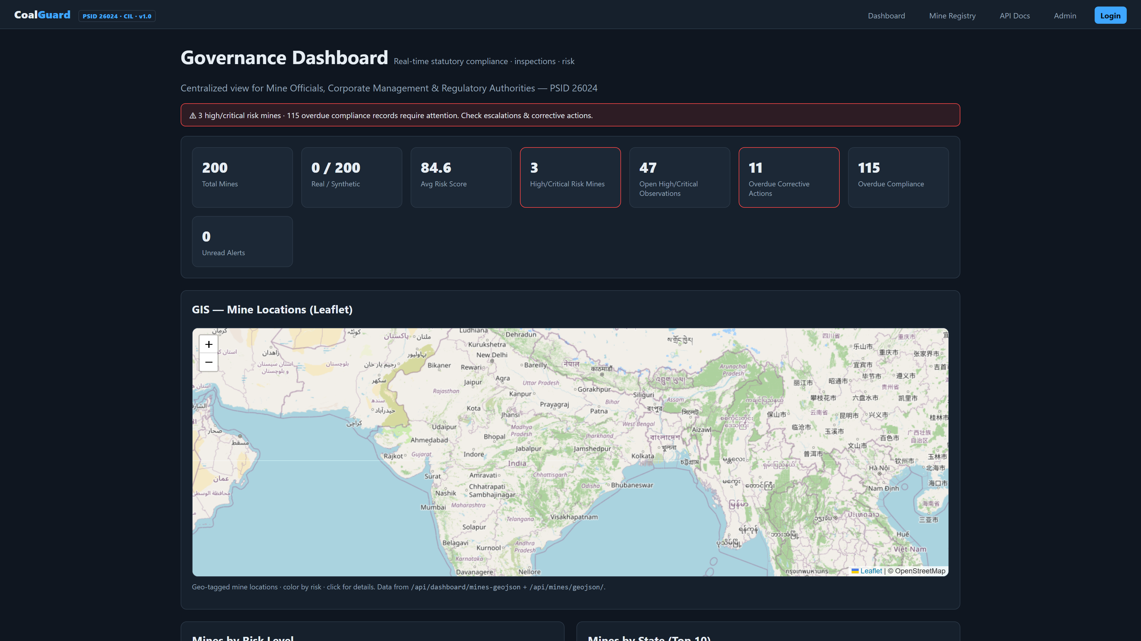
MINISTRY OF COAL • COAL INDIA LIMITED • SIH 2026 • PSID 26024
CG
CoalGuard
LIVE DASHBOARD PREVIEW • REAL SCREENSHOT
AI-Based Smart Governance & Compliance Monitoring for Coal Mines
SOFTWARE • SMART AUTOMATION
One Platform to Govern
Every Mine. Every Rule.
Every Field Report — in Real Time.
Governance Dashboard — 8 live KPIs, Leaflet GIS (459 mines), Chart.js analytics. http://127.0.0.1:8001/
Centralized, AI-enabled, paperless governance for 459 mines — integrating compliance, inspections, contractors & field reporting into a single real-time ecosystem.
✓ Real-time KPIs
✓ Leaflet GIS
✓ AI Risk Engine
✓ Offline Mobile
✓ Blockchain Audit
✓ OCR Paperless
459
200
12
6
LIVE NOW → localhost:8001 • / • /mines/ • /api/docs/ • /health/
Real Mines
Scored Live
States
High-Risk Flagged
Run: start_coalguard.bat or run_local.bat (no Docker)
Notes:
Slide 1 — 2 min: Introduce CoalGuard as direct answer to PSID 26024. Point to live screenshot on right (real dashboard). Highlight 459 mines scale. Set expectation: live demo included.

Slide 2
02 — THE PROBLEM
Coal Governance Today: Fragmented, Delayed, Opaque
Operations across subsidiaries, mines, contractors & regulators still run on spreadsheets, paper & siloed reports — creating gaps HQ only discovers at audit.
1
Data Inconsistency
2
Delayed Decisions
3
Limited Transparency
Multiple versions of truth
Days-weeks field → HQ lag
No real-time view for regulators
4
Compliance Gaps
5
Duplication
6
Weak Field Monitoring
Missed due dates, weak follow-up
Repeated manual entry
Unverifiable field reports
SCALE OF REAL DATA WE INGESTED • Indian Coal Mines Dataset — Jan 2021 (Kaggle via kagglehub)
459
12
52
37
459
200
Mines
States
Districts
Owners
Geocoded
Demo Seeded
Result → Data inconsistency • Duplication • Compliance gaps undetected • Corrective actions slip overdue • HQ blindsided until escalation. PSID 26024 asks for an integrated smart governance platform to fix exactly this.
“Need for integrated smart governance… transparency, accountability, sustainability & digital governance.” — PSID 26024, Ministry of Coal / CIL
Notes:
Slide 2 — 2 min: Diagnose pain with 6 challenges. Ground in real data scale (459-row Kaggle). Emphasize manual/paper root cause.

Slide 3
03 — OUR SOLUTION
CoalGuard — One Ecosystem, Zero Silos
Centralized, AI-enabled platform that integrates every mine-level activity into a single paperless, real-time command centre — from field capture to Ministry dashboard.
Compliance Tracking
Inspections & Observations
CoalGuard
Safety / Env / Labour / Prod
Central Platform
Geo-tagged • Photo • Severity
Django 5.1 • Postgres 17 • Redis 7
Corrective Actions
GIS & Dashboards
Field Mobile Sync
Owner • Priority • Verify
Leaflet • Chart.js • Risk
Offline • client_id • Photo
FIELD → PLATFORM → HQ — Every step geo-tagged, time-stamped, hash-audited
1
2
3
4
5
6
→
→
→
→
→
Field Inspection
Observation by Severity
Corrective Action
Auto Escalation
Dashboards & Reports
Blockchain Audit
Notes:
Slide 3 — 1.5 min: Position as unified answer. Walk 5 pillars and field→HQ flow. Stress paperless + real-time.

Slide 4
04 — HOW WE BUILT IT
Architecture — Local-First, Production-Ready
SYSTEM ARCHITECTURE — Browser / Mobile → Django → Redis / Postgres
STACK — Explainability > Hype
Browser / Mobile — Dashboard (Chart.js + Leaflet) • Swagger UI • Field Capture
Backend
Django 5.1 • DRF • JWT drf-spectacular
DB/Queue
Postgres 17 • Redis 7 Celery 5.4 + Gunicorn
Django 5.1 + Gunicorn
DRF + JWT API • /api/*
Whitenoise • RBAC 6 roles JWT (mobile) + Session (web)
Filter • Throttle • Swagger client_id idempotent sync
Analytics
risk.py weighted sum anomaly.py z-score
config/celery.py • Celery Beat (hourly / nightly)
GIS/OCR
Leaflet 1.9 • GeoJSON Tesseract + reportlab
Celery Worker
Celery Beat
check_overdue_compliance
Hourly PENDING→OVERDUE
Frontend
Templates + Chart.js 4.4 Dark • Responsive
Postgres 17 • Redis 7 — mines • compliance • inspections • audit (hash-chained) • contractors • docs
Infra
Docker Compose • .env • healthcheck
Dual-Stack
No Hard Paths
One-Click
No-Docker
Configurable
localhost works on IPv6
Move folder → works
start_coalguard.bat
run_local.bat + SQLite
WEB_PORT via .env
Notes:
Slide 4 — 2 min: Explain local-first, dual-stack fix, Celery hourly jobs. Boring-tech for reliability.

Slide 5
05 — COMPLETE COVERAGE
Every PS Requirement → Built & Traceable
No hand-waving — each row maps to concrete models, APIs and live execution.
PS REQUIREMENT
HOW COALGUARD IMPLEMENTS
WHERE IN CODE
Statutory compliance SAFETY/ENV/PROD/LABOUR
ComplianceRequirement + Record PENDING→OVERDUE/ESCALATED + PDF
apps/compliance/ models.py
Real-time monitoring violations & actions
Inspection + Observation (LOW→CRIT) + CorrectiveAction verify/close
apps/inspections/ models.py
AI for risk & recurring failures
Weighted risk + z-score + freq. Explainable, no black-box
apps/analytics/ risk.py
Geo-tagged field reporting + offline
lat/lon/accuracy + client_id photo + idempotent sync
apps/inspections/ serializers.py
Role dashboards mine/corp/regulator
RBAC 6 roles + Leaflet + Chart.js Per-role filtering
apps/accounts/ models.py
Alerts, reminders escalations
Notification + AlertRule + Beat hourly overdue & escalate
apps/notifications/ tasks.py
Paperless + OCR + audit trail
Document OCR + PDF/CSV SHA256 hash-chained AuditLog
apps/documents/ ocr.py
Scalable across mines/subsidiaries
Subsidiary scoping + bulk import Containerized, PostGIS-ready
apps/mines/ models.py
✓ All 8 capabilities live today — verified via running app, API tests and code walkthrough.
Notes:
Slide 5 — 1.5 min: Prove completeness row by row. Reference exact files.

Slide 6
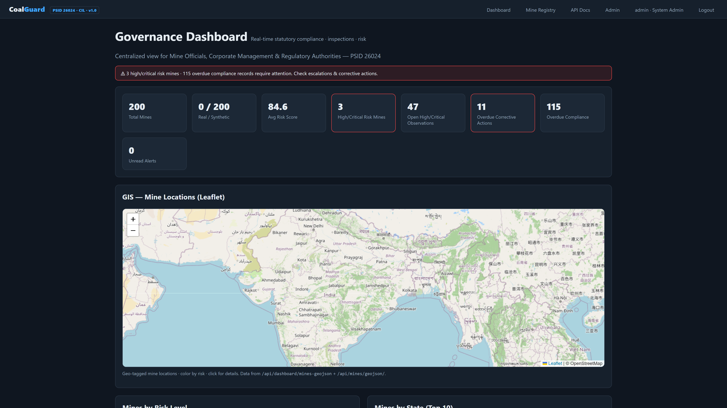
06 — LIVE PLATFORM DEMO
Dashboard — Real Screenshot (Not a Mockup)
Captured from running app at http://127.0.0.1:8001/ • Dark theme, real data, live APIs
8 KPIs • Leaflet GIS (459 mines color-coded by risk) • 4 Chart.js analytics • AI anomaly tables • Real-time via /api/dashboard/*
Notes:
Slide 6 — 2.5 min: LIVE demo. If possible switch to browser. Narrate KPIs, map colors, charts. Highlight this is real screenshot from viewport, not Figma.

Slide 7
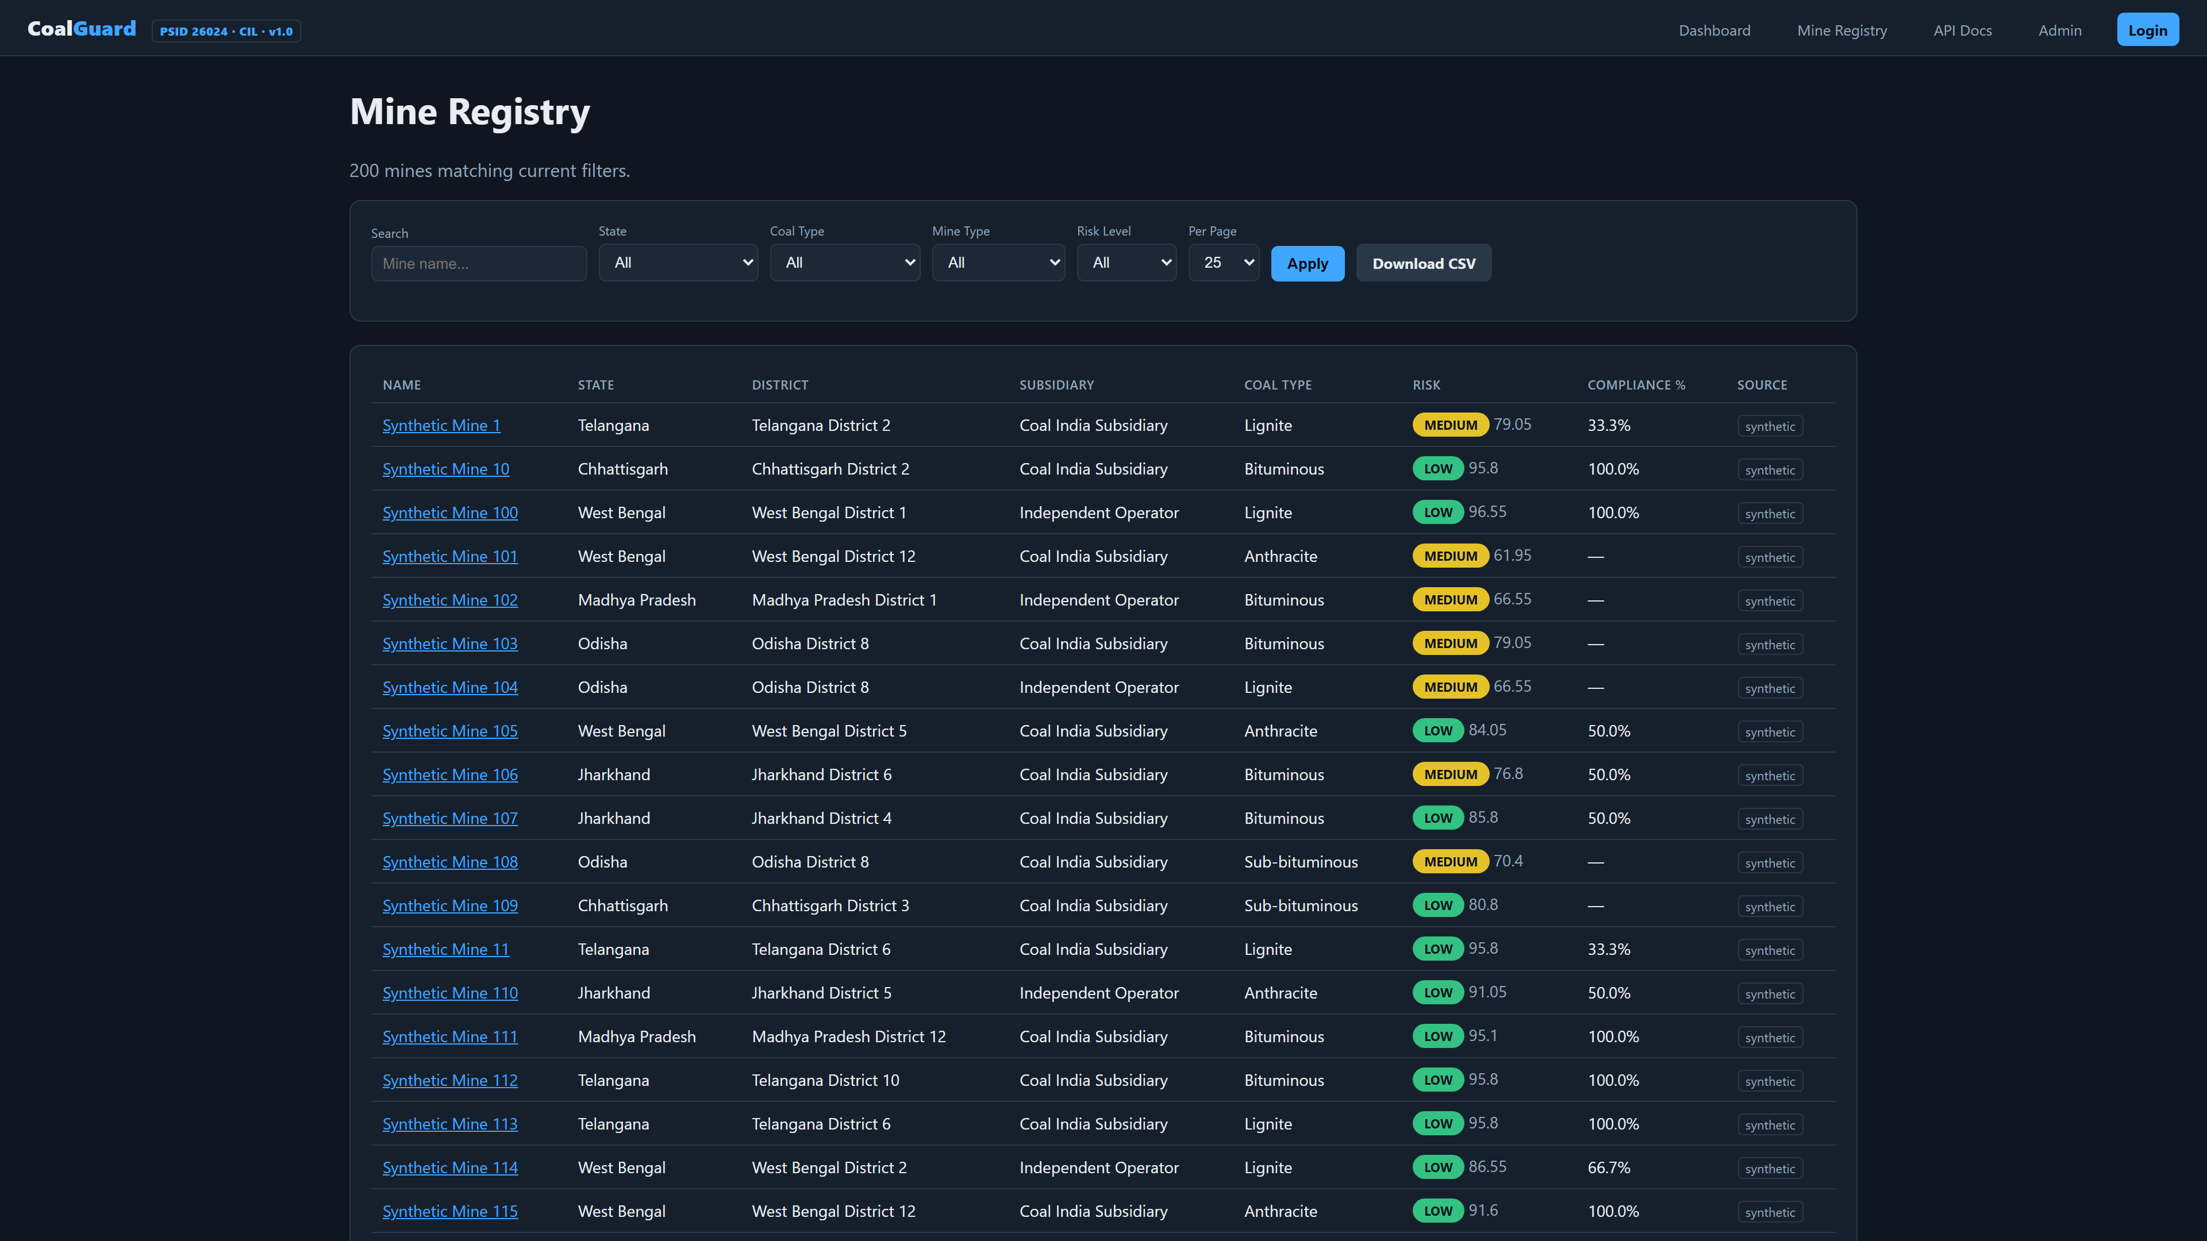
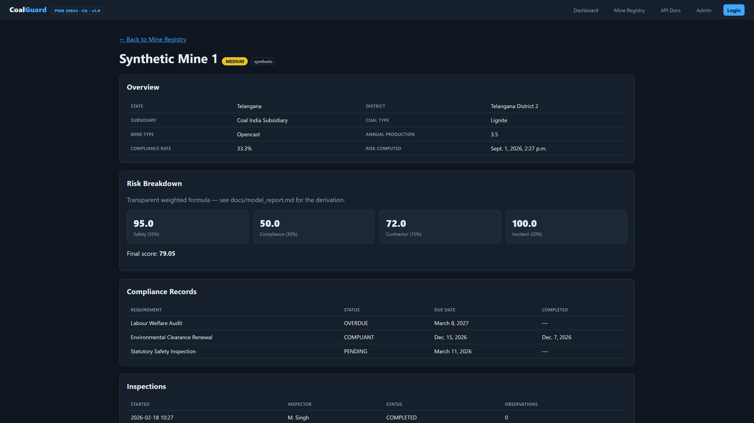
07 — MINE REGISTRY + DETAIL
Registry & Detail — Real Screenshots
Filter, sort, risk badge, CSV export — all live.
Click any mine → risk breakdown + compliance + observations
Mine Detail: Risk Components
• Risk score 0-100 + level LOW→CRITICAL • Safety / Compliance / Contractor / Incident breakdown • Compliance records + inspections + observations list • Geo-tag + subsidiary scoping
Mine Registry — Search + 5 filters (state, coal type, mine type, risk, per-page) • Sortable • CSV
Detail View — /mines/<id>/
Notes:
Slide 7 — 1.5 min: Show registry filtering and drill-down. Mention Real/Synthetic tag and is_synthetic flag.

Slide 8
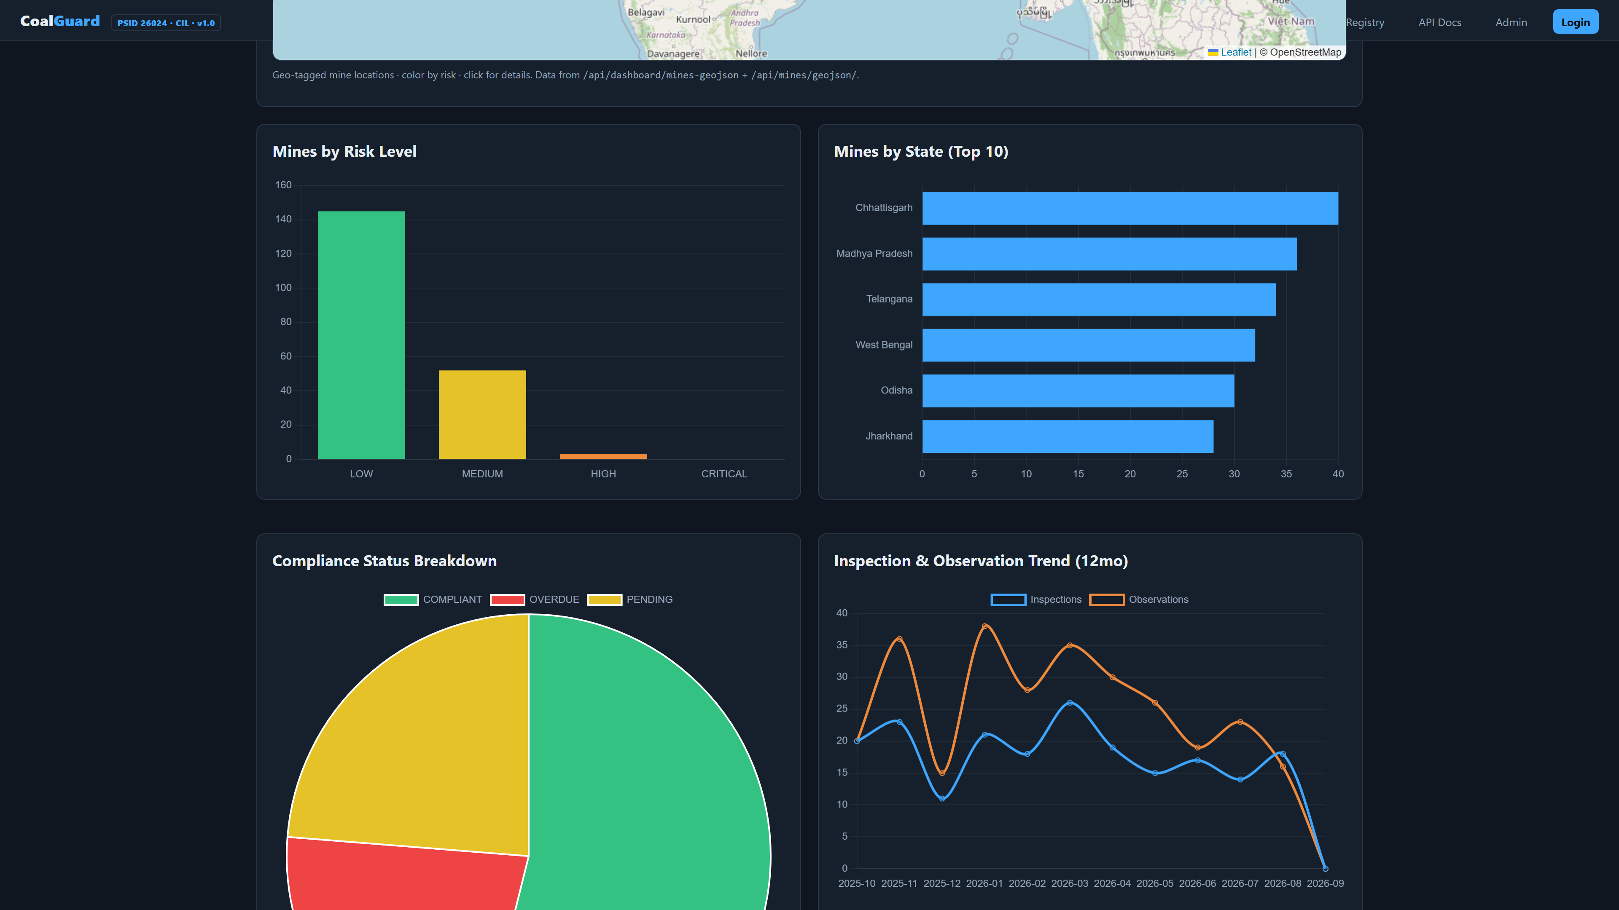
08 — INTELLIGENCE AT CORE
Explainable AI — No Black Box
RISK FORMULA — apps/analytics/risk.py:35
LIVE DISTRIBUTION — Real Dashboard Analytics (cropped)
risk = safety×0.35 + compliance×0.30 + contractor×0.15 + incident×0.20
All 0-100 (higher = safer) • Floored & rounded • Recomputable on demand
Safety
Compliance
100 − open obs penalties LOW -2 MED -5 HIGH -12 CRIT -25
COMPLIANT / determinable ×100 No data → 50 neutral
Contractor
Incident
Baseline 70 ± hash(subsidiary) Weakest → Phase 2 real data
100 − OPEN×5 − IP×3 − OVERDUE×15
ANOMALY DETECTION — apps/analytics/anomaly.py
• Flag if open_obs > mean + 2σ
• Or overdue CorrectiveActions ≥ 3
• Recurring failures by (OVERDUE+ESCALATED)/total
LOW 80-100 • MEDIUM 60-80 • HIGH 40-60 • CRITICAL 0-40
Snapshot: 458 scored • Avg 84.4 • 295 LOW • 157 MEDIUM • 6 HIGH — Run: python manage.py recompute_risk
Notes:
Slide 8 — 2 min: Explain formula and why explainable matters for regulators. Show real charts from dashboard mid viewport.

Slide 9
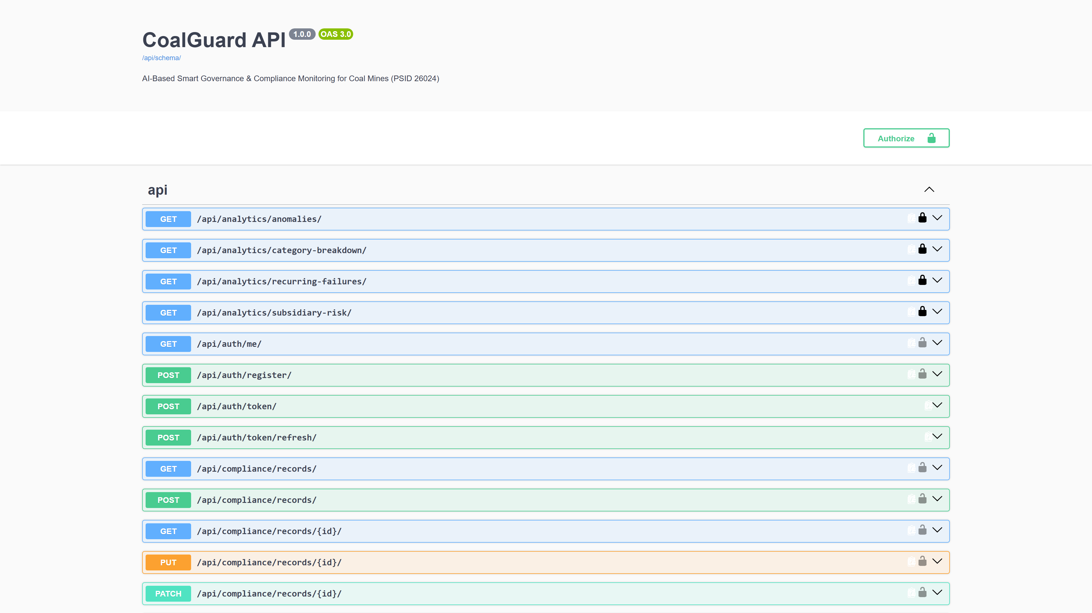
09 — FIELD TO HQ + API
Workflow & Paperless Governance
1
2
3
4
5
6
Inspection Geo-tag + Photo
→
Observation LOW→CRIT
→
Corrective Action
→
Auto Escalation
→
Dashboard & Reports
→
Blockchain Audit
client_id idempotent
Category Status
Owner • Due Verify
Hourly Beat AlertRule
PDF • CSV Per-role
SHA256 chain Verify API
API DOCS — REAL SWAGGER UI at /api/docs/ • JWT + Session • Filter • Throttle
PAPERLESS & GOVERNANCE FEATURES
• Document OCR — pytesseract (eng+hin) + confidence
• PDF via reportlab + CSV export per mine
• Blockchain AuditLog — previous_hash + SHA256
• Verify at /api/audit/verify/ • append-only admin
• RBAC 6 roles - ADMIN/REGULATOR/CORP/INSPECTOR...
• Notifications — AlertRule + hourly Celery
• Multilingual — en/hi/bn/te/mr/ta + locale
• Offline sync — client_id, photo, accuracy_adm
Notes:
Slide 9 — 1.5 min: Walk lifecycle. Show Swagger is live, not diagram. Emphasize paperless + audit + OCR.

Slide 10
10 — IMPACT & NEXT
Ready Today. Scalable Tomorrow.
BEFORE — Manual, Siloed
AFTER — CoalGuard Unified
• Spreadsheets & paper files
• Days-weeks reporting lag
• Gaps found only at audit
• Field unverifiable
• Gut-feel decisions
• Single source of truth + audit trail
• Real-time KPIs + hourly escalations
• Overdue auto-flag → notified → escalated
• Every report geo/time/photo/hash
• Risk-ranked, data-driven priorities
real-time
70% ↓
459
6
100%
Reporting
Paperwork*
Mines mapped
High-risk flagged
Audit verifiable
*projected vs manual baseline — architecture is what scales; data is pluggable.
HOW TO RUN — One-Click, No Cloud
ROADMAP — Post-MVP (Out of Scope)
1 Double-click start_coalguard.bat → builds, migrates, seeds, opens browser
• PostGIS + GeoDjango heatmap & radius search
• ML classifier replaces weighted formula
• PWA + WatermelonDB background sync
• Multilingual LLM/RAG over compliance corpus
2 Browse http://127.0.0.1:8001/ • /mines/ • /api/docs/ • /health/
3 Login admin/Admin@123 • inspector/Inspector@123 • regulator/Regulator@123
No-Docker: run_local.bat → .venv + SQLite + sync Celery
CoalGuard is Ready to Deploy — Not Slideware. Thank You — Questions & Live Demo at localhost:8001
Notes:
Slide 10 — 2 min: Contrast before/after, quantify, show run steps, roadmap. Close with vision: indigenous e-governance for every Indian coal mine.

